Slide 1
Force directed Graph Drawing
door Jesse van der Ceelen, Michiel van Heusden en Maurits van der Veen

Slide 2
Overview
Problem description
Research question
Hypothesis
The experiment
Results
Conclusion

Slide 3
Problem description
Graphs can be large and complex
What can go wrong?
Vertices too far apart – or too close
Overlapping edges or vertices
Cluttering

Slide 4
Problem description
Force-directed graph drawing
Move vertices with predefined forces
Physical systems stabilize well
Iterate force calculations on vertices
Repulsive forces between all vertices
Attractive forces between connected vertices

Slide 5
Problem description
Different algorithms exists, we will look at:
Hooke-Coulomb
Fruchterman Reingold
Eades
Each algorithm…
calculates the forces in a different way
has multiple parameters

Slide 6
Research question
Which system of forces in force-­directed graph drawing gives the highest quality display result?

Slide 7
Hypothesis
Expecting all algorithms to work equally well
There must be optimal values for each one

Slide 8

The experiment
Hooke-Coulomb algorithm
Attractive force:
$F_{a}(i,j)=c(l_{d}−l_{0})$
Repulsive force:
$F_{r}=α\frac{1}{{|\vec{r_{i,j}}|}^{3}}$ $\vec{r_{i,j}}$
Parameters: weight $c$ : [0.0001~0.4] weight $α$ : [0.0001~0.2]

Slide 9
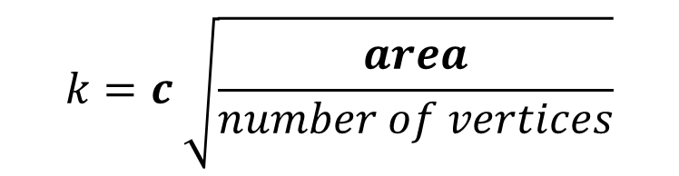
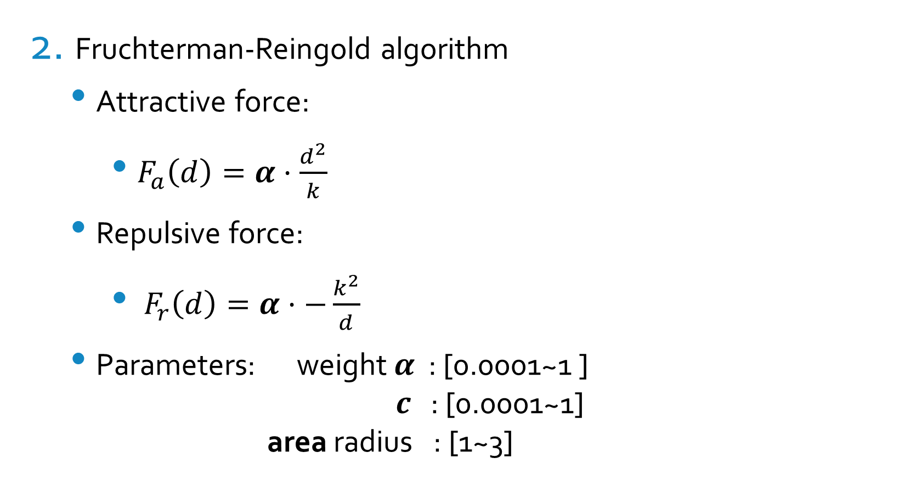
The experiment
Fruchterman-Reingold algorithm
Attractive force:
$F_{a}\left(d\right)=α·\left.\frac{d^{2}}{k}\right.$
Repulsive force:
$F_{r}\left(d\right)=α·−\left.\frac{k^{2}}{d}\right.$
Parameters: weight $α$ : [0.0001~1 ] $c$ : [0.0001~1] area radius : [1~3]
$$k=c \sqrt{\frac{area}{number of vertices}}$$

Slide 10

The experiment
Eades’ algorithm
Attractive force (logarithmic variant of Hooke’s law):
$F_{a}=c_{1} log\left(\frac{1}{c_{2}}\right) \text{·} r_{n}$
Repulsive force:
$F_{r}=α \frac{1}{{|\vec{r_{i,j}}|}^{3}}$ $\vec{r_{i,j}}$
Parameters: weight $c_{1}$ : [0.0001~0.4] weight $α$ : [0.0001~0.4] log weight $c_{2}$ : [0.0001~1.0]

Slide 11
The experiment
Test data
10 randomly generated graphs
20 vertices
Vertex positions [x,y] → double between 0 and 1
Every vertex has at least one connection

Slide 12
The experiment
Running the algorithms
Run each algorithm
10 different settings for each parameter
Maximum of 100 iterations per graph

Slide 13
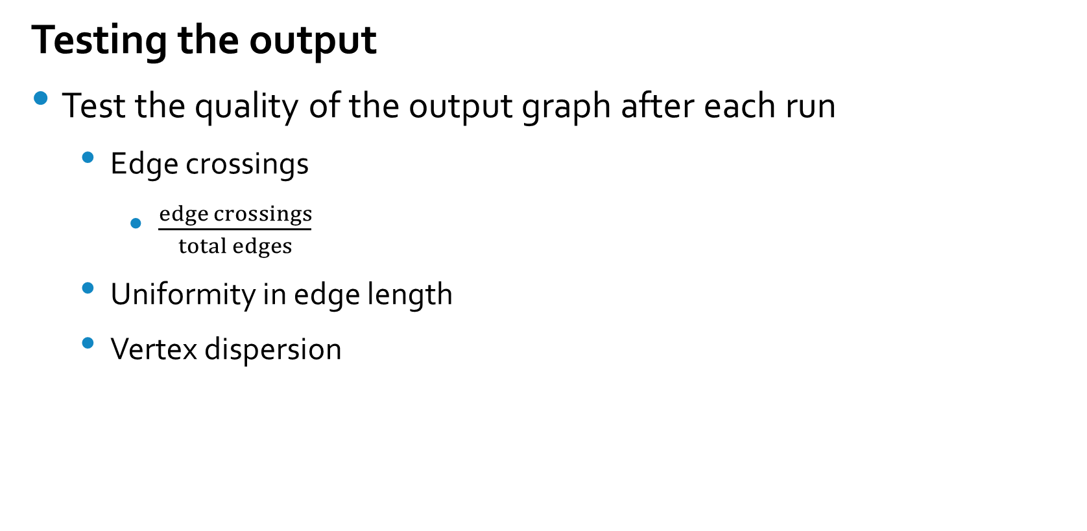
The experiment
Testing the output
Test the quality of the output graph after each run
Edge crossings
$\frac{edge crossings}{total edges}$
Uniformity in edge length
Vertex dispersion

Slide 14
The experiment
Testing the output
Test the quality of the output graph after each run
Edge crossings
Uniformity in edge length
<…>
Vertex dispersion

Slide 15
The experiment
Testing the output
Test the quality of the output graph after each run
Edge crossings
Uniformity in edge length
Vertex dispersion
<…>

Slide 16
The experiment
Testing the output
Test the quality of the output graph after each run
Edge crossings
Uniformity in edge length
Vertex dispersion
Calculate average of the quality values of the 10 inputs graphs

Slide 17
Results
Comparing the algorithms
Hooke-Coulomb vs Fruchterman-Reingold
One-Sample test
Eades vs Fruchterman-Reingold
One-Sample test
Influence of logarithmic weight in Eades
Paired t-test

Slide 18
Results
Hooke-Coulomb vs Fruchterman-Reingold
One-Sample Statistics
 | N | Mean | Std. Deviation | Std. Error Mean
FruchtRein | 1000 | 2.019127749 | 0.3010982911 | 0.0095215640
One-Sample test
 | Test Value = 1.58984455715541
 | t | df | Sig. (2-tailed) | Mean Difference | 95% confidence interval of the difference
 |  |  |  |  | Lower | Upper
FruchtRein | 45.085 | 999 | 0.000 | 0.4292831918 | 0.4105986320 | 0.4479677516

Slide 19
Results
Eades vs Fruchterman-Reingold
One-Sample Statistics
 | N | Mean | Std. Deviation | Std. Error Mean
FruchtRein | 1000 | 2.019127749 | 0.3010982911 | 0.0095215640
One-Sample test
 | Test Value = 1.58984455715541
 | t | df | Sig. (2-tailed) | Mean Difference | 95% confidence interval of the difference
 |  |  |  |  | Lower | Upper
FruchtRein | -342.088 | 999 | 0.000 | -3.25721300 | -3.27589756 | -3.23852844

Slide 20
Results
Influence of logarithmic constant in Eades
Paired Sample Statistics
 | Mean | N | Std. Deviation | Std. Error Mean
Pair 1 LowLoga HighLoga | 5.187399638 5.311963134 | 100 100 | 0.8373754702 0.7908110308 | 0.0837375470 0.0790811031
Paired Sample Correlations
 | N | Correlation | Sig.
Pair 1 LowLoga & HighLoga | 100 | 0.937 | 0.000

Slide 21
Results
Influence of logarithmic constant in Eades
Paired Samples test
 | Paired Differences |  |  |  |  | t | df | Sig. (2-tailed)
 | Mean | Std. Deviation | Std. Error Mean | 95% confidence interval of the difference
 |  |  |  | Lower | Upper
Pair 1 LowLoga - HighLoga | -0.124563495 | 0.2931421157 | 0.0293142116 | -0.182729251 | -0.066397740 | -4.249 | 99 | 0.000

Slide 22
Conclusion
Hooke-Coulomb is significantly better than Fruchterman-Reingold
Eades is significantly worse than Fruchterman-Reingold
High logarithmic weight is significantly better in Eades

